Slide 1
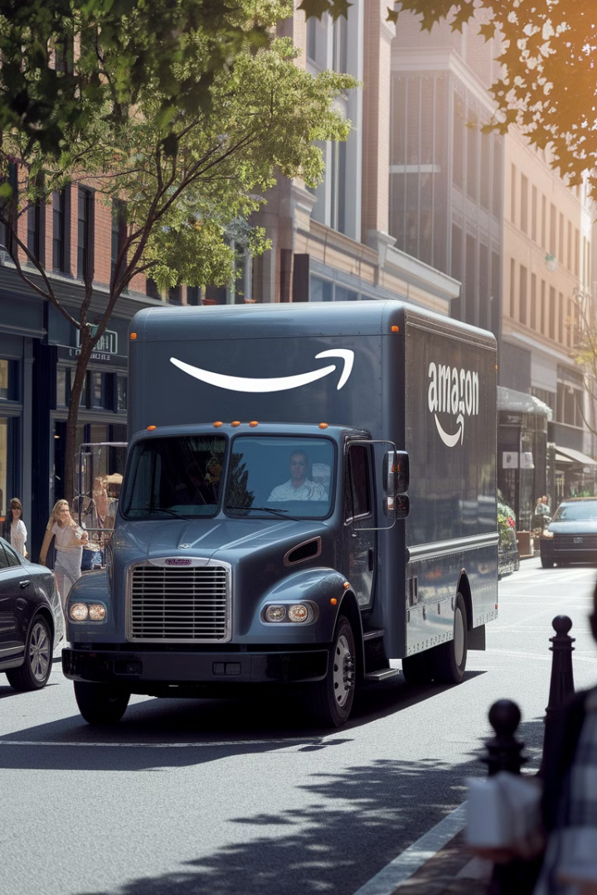
Amazon-Delivery-Time-Prediction 🚚⏱️
This project aims to predict delivery times for e-commerce orders based on factors such as product size, distance, traffic conditions, and shipping methods. By leveraging machine learning techniques, we develop regression models to estimate delivery times accurately. A user-friendly Streamlit application allows users to input order details and receive estimated delivery times.
by Saranya S

Slide 2
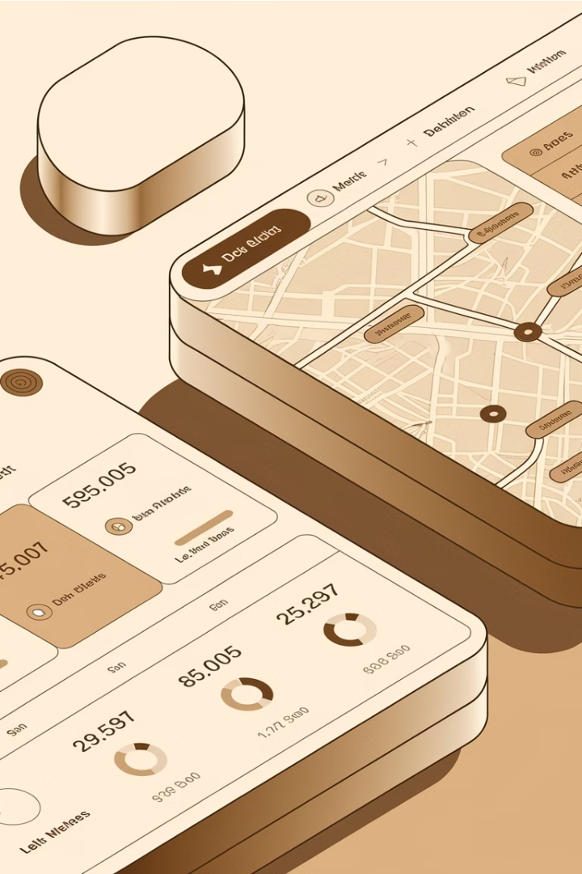
Business Use Cases
1
Enhanced Delivery Logistics
Predict delivery times to optimize schedules and improve customer satisfaction.
2
Dynamic Adjustments
Adjust delivery estimates based on real-time traffic and weather conditions.
3
Agent Performance Evaluation
Assess delivery agent efficiency.
4
Operational Efficiency
Optimize resource allocation for deliveries.

Slide 3

Dataset: (amazon_delivery.csv)
Order Details
Order ID, date, time.
Agent Information
Age, rating.
Location Data
Store & drop coordinates.
Delivery Conditions
Weather, traffic, vehicle type.
Target Variable
Delivery time in hours.

Slide 4
Methodology:

Slide 5

Data Preparation
Load and preprocess the dataset.
Handle missing or inconsistent data.
Perform feature engineering (e.g., calculating distance between store and drop locations).

Slide 6


Data Cleaning
Remove duplicates and handle missing values.
Standardize categorical variables (e.g., weather, traffic).

Slide 7

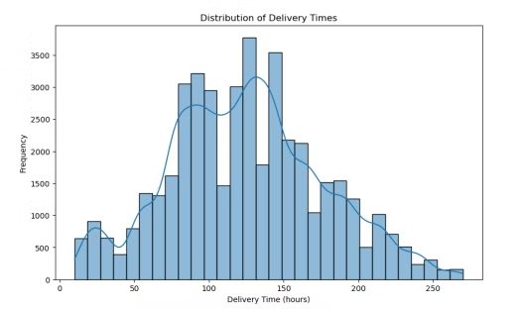
Exploratory Data Analysis (EDA)
Analyze trends in delivery times, agent performance, and external factors.
Visualize the impact of traffic, weather, and other variables on delivery times.

Slide 8

Feature Engineering
Calculate geospatial distances using store and drop coordinates.
Extract time-based features (e.g., hour of day, day of the week).

Slide 9

Model Development
Train multiple regression models:
Linear Regression
Random Forest Regressor
Gradient Boosting Regressor
XGBRegressor
SVR
Evaluate models using metrics like RMSE, MAE, and R-squared.
Compare models and track performance metrics using MLflow.

Slide 10

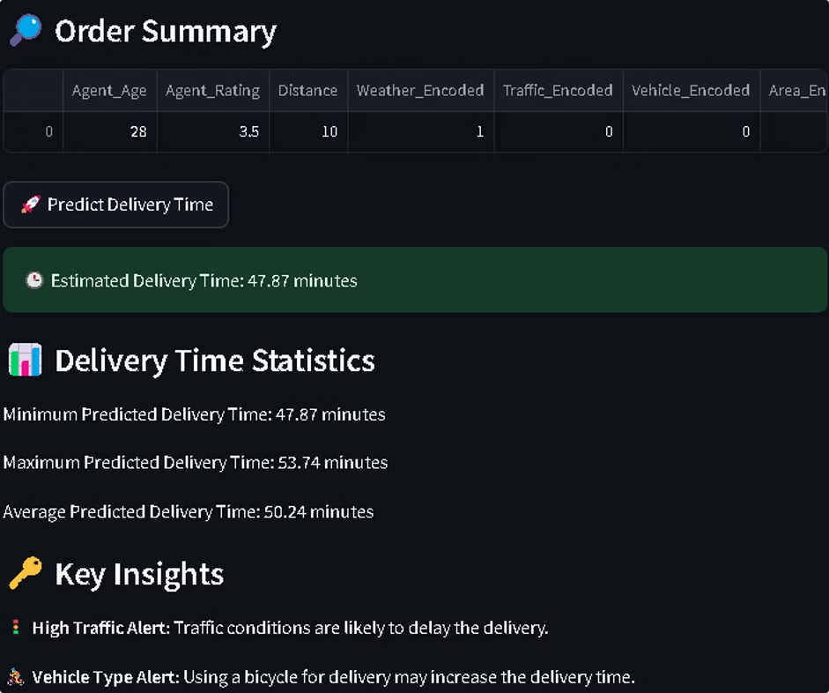
Application Development
Build a user interface using Streamlit to:
Input order details (e.g., distance, traffic, weather, etc.).
Display predicted delivery times.

Slide 11
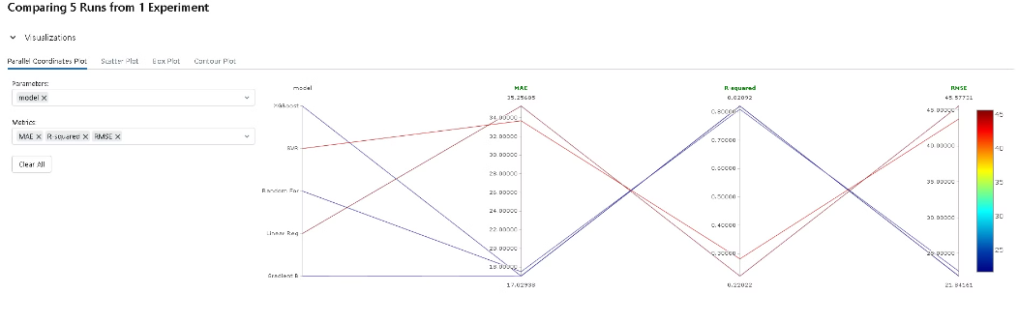
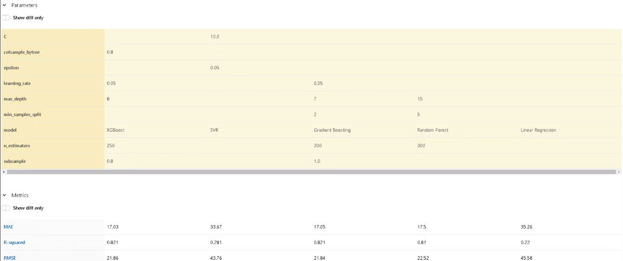
Model Comparison and Tracking
Use MLflow to log, compare, and manage different regression models.
Document the hyperparameters, performance metrics, and model versions.

Slide 12
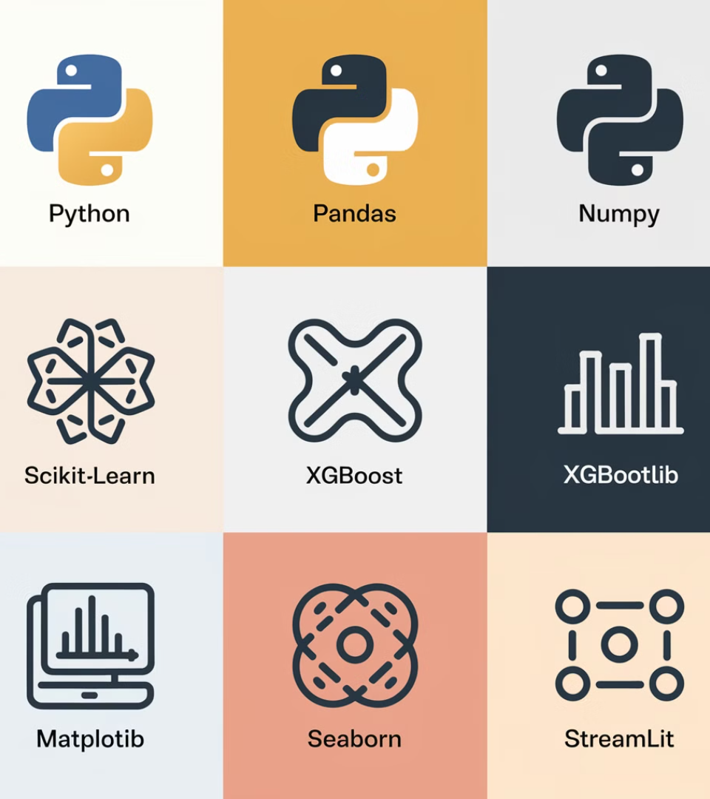




Technical Tags Used
Programming
Libraries
Python
Pandas, NumPy, Scikit-learn, XGBoost, Matplotlib, Seaborn
Model Tracking
Frontend
MLflow
Streamlit

Slide 13
Results
Cleaned Dataset
Regression Models
Streamlit Application
A cleaned and processed dataset ready for modeling.
Multiple regression models developed and tracked using MLflow.
A functional delivery time prediction system accessible via a Streamlit interface.

Slide 14






Deliverables
Source Code
Python scripts for data preparation, EDA, feature engineering, and model development.
Processed Data
Cleaned and prepare dataset ready for analysis.
Regression Models
Trained and evaluated models for delivery time prediction.
Application Code
Streamlit app code with functional prediction capabilities.
Documentation
Detailed documentation explaining the implementation and results
Model Tracking
MLflow logs and model comparisons.

Slide 15
Project Key Learnings
Data Preprocessing: Mastered techniques for handling missing values, outlier detection, and data standardization, resulting in a robust dataset ready for analysis.
EDA: Developed deep insights into delivery patterns through comprehensive analysis of temporal trends, geographical distributions, and key performance indicators.
Feature Engineering: Enhanced model accuracy by creating sophisticated features from raw data, including geospatial calculations and time-based variables.
Machine Learning: Successfully implemented a regression models that captures complex relationships in delivery time predictions, balancing accuracy with interpretability.
MLflow: Gained expertise in systematic experiment tracking and model versioning, enabling reproducible and well-documented machine learning workflows.
Streamlit: Created an intuitive, user-friendly web interface that transforms complex predictions into actionable insights for end-users.

